Slide 1
2016-2017 Volunteer State Book Award High School Division

Slide 2
The Crossover by Kwame Alexander
Fourteen-year-old twin basketball stars Josh and Jordan wrestle with highs and lows on and off the court as their father ignores his declining health.

Slide 3
The Tyrant’s Daughter by J.C. Carleson
Exiled to the United States after her father, a Middle Eastern dictator, is killed in a coup, fifteen-year-old Laila must cope with a completely new way of life, the truth of her father's regime, and her mother and brother's ways of adjusting.

Slide 4
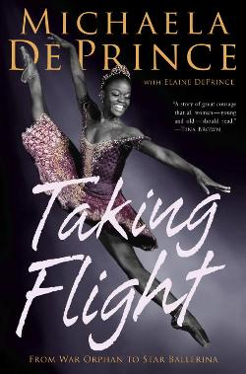
Taking Flight: From War Orphan to Star Ballerina by Michaela DePrince
The autobiography of Michaela DePrince, who lived the first few years of her life in war-torn Sierra Leone until being adopted by an American family. Now seventeen, she is one of the premiere ballerinas in the United States.

Slide 5
The Family Romanov by Candace Fleming
Fleming describes the family of Tsar Nicholas II and the events that led to the Russian Revolution and the demise of Romanovs during World War I.

Slide 6
A Thousand Pieces of You by Claudia Gray
When eighteen-year-old Marguerite Caine's father is killed, she must leap into different dimensions and versions of herself to catch her father's killer and avenge his murder.

Slide 7
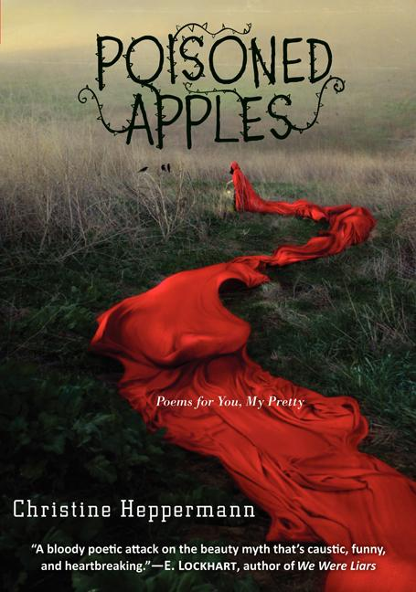
Poisoned Apples: Poems for You, My Pretty by Christine Heppermann
A collection of free verse poems that explores fairy tales and how contemporary girls are taught to think about themselves.

Slide 8
Breathe, Annie, Breathe by Miranda Kenneally
To honor her dead boyfriend and cope with her grief and guilt, college student Annie trains for a marathon with athletic Jeremiah, who flirts with Annie on the trails and makes her feel alive and happy and guilty all at the same time.

Slide 9
Glory O'Brien's History of the Future by A.S. King
As her high school graduation draws near, Glory O'Brien begins having powerful and terrifying visions as she struggles with her long-buried grief over her mother's suicide.

Slide 10
We were liars by e. lockhart
While spending the summers on her family's private island off the coast of Massachusetts with her cousins and their friend Gat, Cadence struggles to remember what happened during her fifteenth summer when she woke up on beach barely clothed and badly injured.

Slide 11
I’ll Give You the Sun by Jandy Nelson
Twins Noah and Jude are inseparable until a tragedy strikes the family and alters their relationship with each other in dramatic fashion.

Slide 12
All the Bright Places by Jennifer Niven
When Theodore and Violet meet on the ledge of the bell tower at school, it's the beginning of an unlikely relationship. They begin a journey to discover the "natural wonders" of the state of Indiana and develop desperate desire to heal and save one another from depression.

Slide 13
The Kiss of Deception by Mary Pearson
On the morning of her wedding, Princess Lia flees to a distant village. She settles into a new life, intrigued when two mysterious and handsome strangers arrive--and unaware that one is the jilted prince and the other an assassin sent to kill her. Deception abounds, and Lia finds herself on the brink of unlocking perilous secrets--even as she finds herself falling in love.

Slide 14
Positive : Surviving My Bullies, Finding Hope, and Living to Change the World by Paige Rawl
The author writes about her experiences of bullying, being HIV positive and surviving the experiences to become a force for positive change in the world.

Slide 15
Fangirl by Rainbow Rowell
Cath, a popular author of fan-fiction, drifts apart from her twin sister and struggles to survive on her own in her first year of college while coping with a surly roommate, falling in love, and worrying about her fragile father.

Slide 16
The Winner’s Curse by Marie Rutkowski
Kestrel, the daughter of a powerful general, purchases a slave at an auction and sets in motion a rebellion that might overthrow her kingdom as well as her heart.

Slide 17
Threatened by Eliot Schrefer
Luc is an orphan, living in debt slavery in Gabon, until he meets a Professor who claims to be studying chimpanzees, and they head off into the jungle--but when the Professor disappears, Luc has to fend for himself and join forces with the chimps to save their forest from poachers.

Slide 18
The Port Chicago 50 by Steve Sheinkin
Sheinkin describes the fifty black sailors who refused to work in unsafe and unfair conditions after an explosion in Port Chicago killed 320 servicemen, and how the incident influenced civil rights.

Slide 19
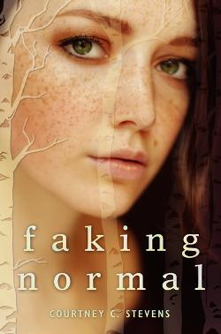
Faking Normal by Courtney C. Stevens
Alexi Littrell hasn't told anyone what happened to her over the summer by her backyard pool. Instead, she hides in her closet, counts the slats in the air vent, and compulsively scratches the back of her neck, trying to make the outside hurt more than the inside does—and deal with the trauma.

Slide 20
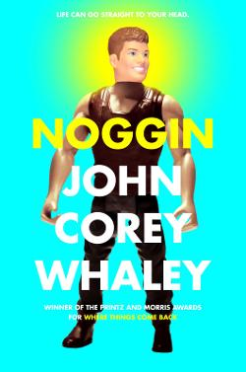
Noggin by John Corey Whaley
After dying at age sixteen, Travis Coates' head was removed and frozen for five years before being attached to another body, and now the old Travis and the new must find a way to coexist while figuring out changes in his relationships.

Slide 21
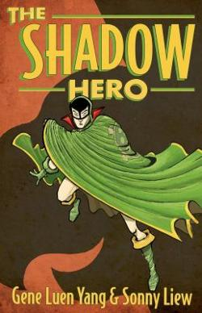
The Shadow Hero by Gene Luen Yang and Sonny Liew
Hank, the nineteen-year-old son of Chinese immigrants, resists his mother's attempts to make him a superhero at first, but when tragedy strikes, he assumes the role of a caped crusader. Aided by one of the four spirits of Chinese mythology, Hank becomes the Green Turtle and sets out to rid Chinatown of the gangsters who have intimidated everyone for years and murdered his father.

