Slide 1
2018-2019 Volunteer State Book Award Intermediate Division

Slide 2
Whoosh: Lonnie Johnsons' Super-Soaking Stream of Inventions by Chris Barton and illustrated by Don Tate.
This book is a biography of Lonnie Johnson, an engineer at NASA who also invented the Super Soaker water gun.

Slide 3
Soar by Joan Bauer
Jeremiah really loves baseball and knows just about everything there is to know about his favorite sport. When he's told he can't play baseball following an operation on his heart, Jeremiah decides he'll do the next best thing and become a coach.

Slide 4
The Wolf’s Boy by Susan Williams Beckhorn
Kai and his wolf, Uff, must brave the long winter together and learn what it takes to survive on their own.

Slide 5
Step Right Up by Donna Janell Bowman and Illustrated by Daniel Minter
Dr. Bill Key, a former slave and self-trained veterinarian taught his horse, Jim, to read and write. Doc and Jim Key became one of the most famous traveling performance acts at the turn of the twentieth century.

Slide 6
The Wild Robot by Peter Brown
Roz the robot discovers that she is alone on a remote, wild island with no memory of where she is from or why she is there, and her only hope of survival is to try to learn about her new environment from the island's hostile inhabitants.

Slide 7
Moo by Sharon Creech
Following her family's momentous move from the city to rural Maine, an unexpected bond develops between Reena and one very stubborn cow.

Slide 8
Nothing but Trouble by Jacqueline Davies
Two smart girls in one small town use their combined scientific genius to liven up their world--one prank at a time.

Slide 9
Raymie Nightingale by Kate DiCamillo
Hoping that if she wins a local beauty pageant her father will come home, Raymie practices twirling a baton and performing good deeds as she is drawn into an unlikely friendship with a drama queen and a saboteur.

Slide 10
Paper Things by Jennifer Jacobson
When forced to choose between staying with her ill-tempered guardian and being with her big brother, Ari chooses to go with her big brother. There's just one problem--Gage doesn't actually have a place to live.

Slide 11
Skunked! By Jacqueline Kelly
When Travis discovers an abandoned baby skunk, he brings him home to take care of him. Stinky settles in pretty well. Then, Travis discovers Stinky's litter-mate who is in need of some help, and things get complicated around the Tate house.

Slide 12
Slacker by Gordon Korman
When Cameron creates the Positive Action Group at school , he intends to fool his parents, teachers, and sister into letting him continue to concentrate on his video-gaming. Before long, other kids are taking the club seriously. He soon finds himself president of the P.A.G. and involved in community service.

Slide 13
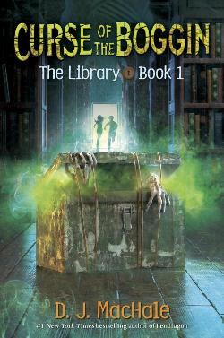
The Curse of the Boggin by D.J. McHale
When supernatural phenomenon start to follow Marcus around, he discovers a key that leads to the Library, a place where all the stories of the living and dead are kept. Will the Library help him and his friends solve a terrifying mystery?

Slide 14
Brave Like My Brother by Marc Tyler Nobleman
When Charlie's older brother Joe goes to war in 1942, Charlie learns about the tedium and dangers of war through Joe's letters which give Charlie the strength to stand up to the local bully.

Slide 15
Six Kids and a Stuffed Cat by Gary Paulsen
It seemed like a normal school day, until a horrible storm forced the very cautious school administration to make everyone hole up in a safe place. Six students find themselves stuck in a tiny, questionably smelly space--a school bathroom--with a stuffed cat for entertainment. Hijinks ensue and the unexpected happens. They enter as strangers but leave as friends

Slide 16
Finding Fortune by Delia Ray
Runaway Ren finds an unusual boarding house in a nearby ghost town, Fortune, where she meets some interesting people and learns of a forgotten treasure from when the town was famous for buttons made of Mississippi River shells.

Slide 17
Towers Falling by Jewell Parker Rhodes
While learning about September 11th, fifth grader Deja realizes how much the events still color her world.

Slide 18
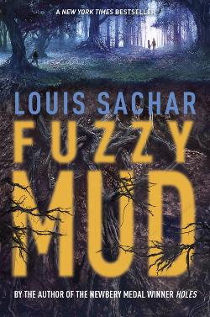
Fuzzy Mud by Louis Sachar
Two kids take a shortcut home from school and discover what looks like fuzzy mud but is actually a substance with the potential to wreak havoc on the entire world.

Slide 19
The Secret Horses of Briar Hill by Megan Shepherd
A girl living in a children's hospital during WWII discovers that a winged horse has entered her world and needs her help.

Slide 20
Ghosts by Raina Telgemeier
Catrina and her family have moved to the coast of Northern California for the sake of her little sister, Maya, who has cystic fibrosis. Cat is even less happy about the move when she is told that her new town is inhabited by ghosts, but Maya sets her heart on meeting one.

Slide 21
Save Me a Seat by Sarah Weeks and Gita Varadarajan
Ravi has just moved to the United States from India and has always been at the top of his class; Joe has lived in the same town his whole life and has learning problems. When their lives intersect in the first week of fifth grade, they are brought together by the biggest bully in their class and the need to take control of their lives.

