Slide 1
2020-2021 Volunteer State Book Award
Primary Division

Slide 2
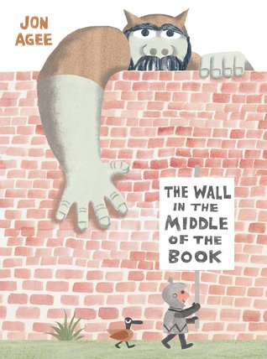
The Wall in the Middle of the Book by Jon Agee
There's a wall in the middle of the book, and our hero—a young knight—is sure that the wall protects his side of the book from the dangers of the other side—like an angry tiger and giant rhino, and worst of all, an ogre who would gobble him up in a second! But our knight doesn't seem to notice the crocodile and growing sea of water that are emerging on his side. When he's almost over his head and calling for help, who will come to his rescue? An individual who isn't as dangerous as the knight thought—from a side of the book that might just have some positive things to offer after all!

Slide 3
I Will Be Fierce! by Bea Birdsong, ill. by Nidhi Chanani
It’s a brand-new day, and a young girl decides to take on the world like a brave explorer heading off on an epic fairytale quest. From home to school and back again, our hero conquers the Mountain of Knowledge (the library), forges new bridges (friendships), and leads the victorious charge home on her steed (the school bus).
This story is a powerful declaration about courage, confidence, kindness, and finding the extraordinary in everyday moments.

Slide 4
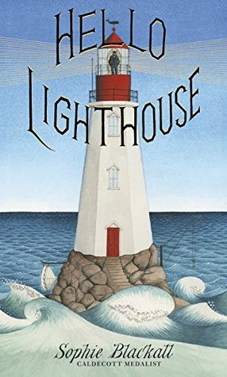
Hello Lighthouse by Sophie Blackall
Watch the days and seasons pass as the wind blows, the fog rolls in, and icebergs drift by. Outside, there is water all around. Inside, the daily life of a lighthouse keeper and his family unfolds as the keeper boils water for tea, lights the lamp's wick, and writes every detail in his logbook.

Slide 5
Hair Love by Matthew A. Cherry, illust. by Vashti Harrison
Zuri’s hair has a mind of its own. It kinks, coils, and curls every which way. Zuri knows it’s beautiful. When mommy does Zuri’s hair, she feels like a superhero. But when mommy is away, it’s up to daddy to step in! And even though daddy has a lot to learn, he LOVES his Zuri. And he’ll do anything to make her—and her hair—happy.
Tender and empowering, Hair Love is an ode to loving your natural hair—and a celebration of daddies and daughters everywhere.

Slide 6
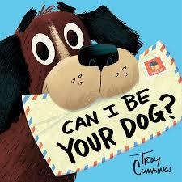
Can I Be Your Dog? by Troy Cummings
Arfy, a homeless mutt lives in a box in an alley. Arfy writes to every person on Butternut Street about what a great pet he'd make. His letters to prospective owners share that he's house broken! He has his own squeaky bone! He can learn to live with cats! But, no one wants him. Won't anyone open their heart--and home--to a lonesome dog?

Slide 7
Planting Stories: The Life Librarian and Storyteller Pura Belpre by Anika Denise, illust. by Paola Escobar
When she came to America in 1921, Pura carried the cuentos folklóricos of her Puerto Rican homeland. Finding a new home at the New York Public Library as a bilingual assistant, she turned her popular stories into libros and spread story seeds across the land. Today, these seeds have grown into a lush landscape as generations of children and cuentistas continue to share her stories and celebrate Pura’s legacy.
This portrait of the influential librarian, author, and puppeteer reminds us of the power of storytelling and the extraordinary woman who opened doors and championed bilingual literature.

Slide 8
The Rabbit Listened by Cori Doerrfeld
When something terrible happens, Taylor doesn't know where to turn. All the animals are sure they have the answer. The chicken wants to talk it out, but Taylor doesn't feel like chatting. The bear thinks Taylor should get angry, but that's not quite right either. One by one, the animals try to tell Taylor how to process this loss, and one by one they fail. Then the rabbit arrives. All the rabbit does is listen, which is just what Taylor needs.

Slide 9
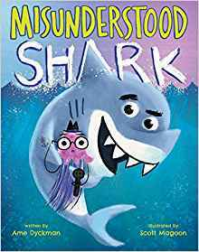
Misunderstood Shark by Ame Dyckman, illust. by Scott Magoon
The filming of an underwater TV show goes awry when the crew gets interrupted by a... SHARRRK! Poor Shark, he wasn't trying to scare them, he's just misunderstood! Then he's accused of trying to eat a fish. Will Shark ever catch a break? After all, he wasn't going to eat the fish, he was just showing it his new tooth! Or was he? With a surprise twist ending, our Misunderstood Shark will have kids rolling with laughter!

Slide 10
Inky the Octopus by Erin Guendelsberger, illust. by David Leonard
Inky the octopus is bored with aquarium life and wants to escape to the ocean! But just how can an octopus in a tank get to the open seas? Find out in Inky the Octopus, the only tale of the mischievous octopus to be officially endorsed by the National Aquarium of New Zealand

Slide 11
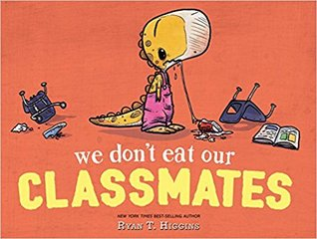
We Don’t Eat Our Classmates by Ryan T. Higgins
Penelope the dinosaur starts school, but it’s hard to make friends when her classmates are so delicious!
It’s the first day of school for Penelope Rex, and she can’t wait to meet her classmates. But it’s hard to make human friends when they’re so darn delicious! That is, until Penelope gets a taste of her own medicine and finds she may not be at the top of the food chain after all...

Slide 12
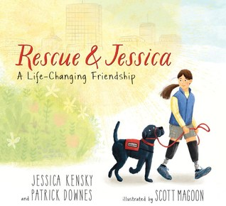
Rescue & Jessica: a Life-Changing Friendship by Jessica Kensky and Patrick Downes
illustrated by Scott Magoon
Rescue thought he'd grow up to be a Seeing Eye dog -- it's the family business, after all. When he gets the news that he's better suited to being a service dog, he's worried that he's not up to the task. Then he meets Jessica, a girl whose life is turning out differently than the way she'd imagined it, too. Now Jessica needs Rescue by her side to help her accomplish everyday tasks. And it turns out that Rescue can help Jessica see after all: a way forward, together, one step at a time.

Slide 13
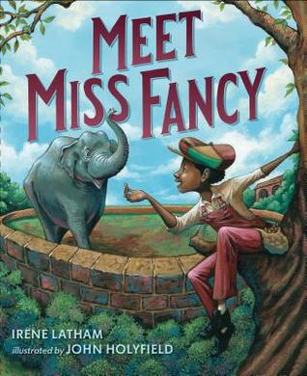
Meet Miss Fancy by Irene Latham, illust. by John Holyfield
Frank has always been obsessed with elephants. So when Miss Fancy, the elephant, retires from the circus and moves two blocks from his house to Avondale Park, he's over the moon! Avondale Park is just for white people, so Frank is not allowed to see Miss Fancy. Frank doesn't give up: instead he makes a plan!
Frank writes to the City Council so his church can host a picnic in the park, and he can finally meet Miss Fancy. All of his neighbors sign the letter, but when some protest, the picnic is cancelled and Frank is heartbroken all over again. Then Miss Fancy escapes the zoo, and it's up to Frank to find her before she gets hurt.

Slide 14
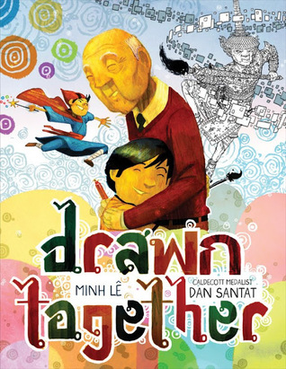
Drawn Together by Minh Le, illust. by Dan Dantat
When a young boy visits his grandfather, their lack of a common language leads to confusion, frustration, and silence. But as they sit down to draw together, something magical happens-with a shared love of art and storytelling, the two form a bond that goes beyond words.

Slide 15
The Rough Patch by Brian Lies
Evan and his dog do everything together, including caring for their award-winning garden. One day the unthinkable happens: Evan’s dog dies. Heartbroken, Evan destroys the garden and everything in it. The ground becomes overgrown with prickles and thorns, and Evan embraces the chaos.
But beauty grows in the darkest of places, and when a twisting vine turns into an immense pumpkin, Evan is drawn out of his misery and back to the county fair, where friendships—old and new—await.

Slide 16
The Dinosaur Expert by Margaret McNamara, illust. by G. Brian Karas
Mr. Tiffin and his students are back in another picture book, and this time the focus is on dinosaur-loving Kimmy. During a field trip to the natural history museum, Kimmy is thrilled to share what she knows about the Stegosaurus and the Archaeopteryx and even the ginormous Titanosaurus. That changes when one of her classmates questions whether girls can be paleontologists. Kimmy starts to feel shy. What if they can’t? What if no one wants to hear what she has to say? It will take some help from Mr. Tiffin–and from a famous scientist–for Kimmy to find her voice again.

Slide 17
Rooster Wore Skinny Jeans by Jessie Miller, illust. by Barbara Bakos
Rooster is so excited when his new skinny jeans arrive: the sparkling stitching, a striking gold hue, and the indigo denim, a dazzling blue! But what will the other animals think of his stunning new style?

Slide 18
Saturday by Oge Mora
In this heartfelt and universal story, a mother and daughter look forward to their special Saturday routine together every single week. But this Saturday, one thing after another goes wrong–ruining storytime, salon time, picnic time, and the puppet show they’d been looking forward to going to all week. Mom is nearing a meltdown…until her loving daughter reminds her that being together is the most important thing of all.

Slide 19
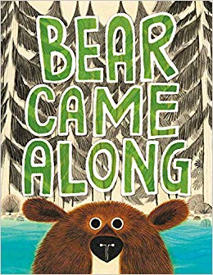
Bear Came Along by Richard T. Morris, illust. by LeUyen Pham
Once there was a river flowing through a forest. The river didn't know it was capable of adventures until a big bear came along. But adventures aren't any fun by yourself, and so enters Froggy, Turtles, Beaver, Racoons, and Duck.
These very different animals take off downstream, but they didn't know they needed one another until thankfully, the river came along.
This hilarious picture book and heartfelt message celebrates the joy and fun that's in store when you embark together on a ride of a lifetime.

Slide 20
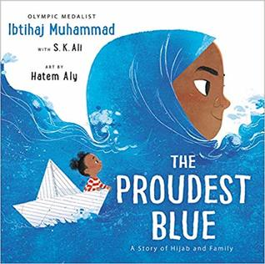
The Proudest Blue: A Story of Hijab and Family by Ibtihaj Muhammad, illust. by Hatem Aly
With her new backpack and light-up shoes, Faizah knows the first day of school is going to be special. It's the start of a brand new year and, best of all, it's her older sister Asiya's first day of hijab--a hijab of beautiful blue fabric, like the ocean waving to the sky. But not everyone sees hijab as beautiful, and in the face of hurtful, confusing words, Faizah will find new ways to be strong.
Paired with Hatem Aly's beautiful, whimsical art, Olympic medalist Ibtihaj Muhammad and Morris Award finalist S.K. Ali bring readers an uplifting, universal story of new experiences, the unbreakable bond between siblings, and of being proud of who you are.

Slide 21
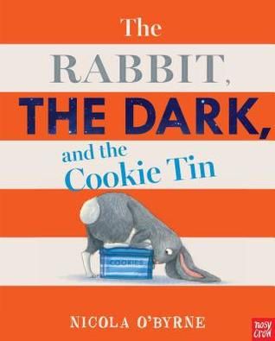
The Rabbit, The Dark, and the Cookie Tin by Nicola O’Byrne
Rabbit doesn't want to go to bed, so he decides to kidnap The Dark and trap it in a cookie tin so he can stay up all night long. But then The Dark reminds Rabbit of all the good things that darkness brings. What about all the nocturnal animals? And surely you can't have a yummy breakfast of toast and honey and fresh orange juice unless you've been to bed? But the BEST thing about the dark, of course, is reading a really good bedtime story!

Slide 22
All Are Welcome
by Alexandra Penfold, illust. by Suzanne Kaufman
Follow a group of children through a day in their school, where everyone is welcomed with open arms. A school where kids in patkas, hijabs, and yamulkes play side-by-side with friends in baseball caps. A school where students grow and learn from each other's traditions and the whole community gathers to celebrate the Lunar New Year.
All Are Welcome lets young children know that no matter what, they have a place, they have a space, they are welcome in their school.

Slide 23
Hey, Water!
by Antoinette Portis
Join a young girl as she explores her surroundings and sees that water is everywhere. But water doesn't always look the same, it doesn't always feel the same, and it shows up in lots of different shapes. Water can be a lake, it can be steam, it can be a tear, or it can even be a snowman.
As the girl discovers water in nature, in weather, in her home, and even inside her own body, water comes to life, and kids will find excitement and joy in water and its many forms.

Slide 24
Otis and Will Discover the Deep
by Barb Rosenstock, illust. by Katherine Roy
The suspenseful, little-known true story of two determined pioneers who made the first dive into the deep ocean.
On June 6, 1930, engineer Otis Barton and explorer Will Beebe dove into the ocean inside a hollow metal ball of their own invention called the Bathysphere.
They knew dozens of things might go wrong. A tiny leak could shoot pressurized water straight through the men like bullets! A single spark could cause their oxygen tanks to explode! No one had ever dived lower than a few hundred feet...and come back. But Otis and Will were determined to become the first people to see what the deep ocean looks like.

Slide 25
Knock, Knock
by Tammi Sauer, illust. by Guy Francis
Knock Knock is a fresh and innovative method of humorous storytelling that uses knock-knock jokes to tell the story of Bear and his woodland friends Raccoon, Rabbit, Turtle, and others. With each new visitor, Bear grows increasingly frustrated at his lack of peace and quiet. Little does Bear know that his friends have a special surprise party in store to welcome him back during springtime!

Slide 26
Lorraine, the Girl Who Sang the Storm Away
by Ketch Secor, illust. by Higgins Bond
Lorraine and her Pa Paw spend their days celebrating life with the music of the Tennessee hills. With Pa Paw's harmonica and Lorraine's pennywhistle, the pair can face just about anything. But when a fearsome storm rolls in and their instruments are nowhere to be found, can Lorraine find the music inside herself to get them through?

Slide 27
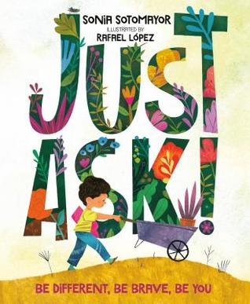
Just Ask! Be Different, Be Brave, Be You
by Sonia Sotomayor, illust. by Rafael Lopez
In Just Ask, United States Supreme Court Justice Sonia Sotomayor celebrates the different abilities kids have. Using her own experience as a child who was diagnosed with diabetes, Justice Sotomayor writes about children with all sorts of challenges—and looks at the special powers those kids have as well. As the kids work together to build a community garden, asking questions of each other along the way, this book encourages readers to do the same: When we come across someone who is different from us but we're not sure why, all we have to do is Just Ask.

Slide 28
The Donkey Egg
by Janet Stevens & Susan Stevens Crummel
Bear would rather sleep all day than work on his farm, and Fox knows just the kind of help he needs—a donkey! When Fox tricks Bear into buying a donkey egg, Bear can't wait for it to hatch so he can meet his new friend. But donkeys don't come from eggs! And when the "egg" finally opens, Bear gets a fruity surprise. Luckily, Bear doesn't have to face disappointment alone . . . Hare is there to help!

Slide 29
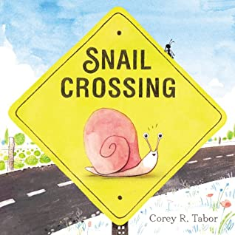
Snail Crossing
by Corey R. Tabor
A determined snail.
A plump cabbage.
A truly epic journey . . .
In a book as cheerful and charming as Snail himself, Corey Tabor tells a winning tale of a slow but steady snail, whose determination and kindness bring him the best reward of all: friendship.

Slide 30
Because
by Mo Willems
Mo Willems, a number one New York Times best-selling author and illustrator, composes a powerful symphony of chance, discovery, persistence, and magic in this moving tale of a young girl's journey to center stage. Illustrator Amber Ren brings Willems' music to life, conducting a stunning picture-book debut.

Slide 31
The Day You Begin
by Jacqueline Woodson, illust. by Rafael Lopez
There are many reasons to feel different. Maybe it's how you look or talk, or where you're from; maybe it's what you eat, or something just as random. It's not easy to take those first steps into a place where nobody really knows you yet, but somehow you do it.
Jacqueline Woodson's lyrical text and Rafael Lopez's dazzling art reminds us that we all feel like outsiders sometimes-and how brave it is that we go forth anyway. And that sometimes, when we reach out and begin to share our stories, others will be happy to meet us halfway.

